Slide 1
Value Analysis / Value Engineering using Novo Cut to Length
Novo Precision Team
2016

Slide 2
Objective
Understand Value Analysis / Value Engineering (VA/VE) opportunity that in certain applications will benefit to your supply chain:
Our consultative approach can help you identify where this can apply
Cost
Engineering a more Value Added Process improving COST
Maintaining or improving Quality & Deliver
Quality
Delivery

Slide 3
Novo Precision Products
Novo has 4 Product Value Streams:
Our Cut to Length & Wire Value Streams leverage capital equipment which we engineer & build.
Wire Production Value Stream
Cut to Length Value Stream
(New)
Machining Value Stream
(New)
Engineer & Build Equipment Value Stream

Slide 4
VA/VE Process
Traditional Approach for Linear parts:
CNC Swiss, CNC Wire Former, CNC Mill or CNC Lathe
Cut to Length for Linear Parts:
Pneumatic or Servo Feed & Cut
Customized Secondary Operations
Potential Cost Advantages:
Lower Capital Equipment Cost
Lower Material cost off coil and straightened versus bar stock
Reduced Expendable Tooling Costs
Reduced Scrap in using shaped or preformed material

Slide 5
Types of Products
Any type of Linear Material generally from .002” to .250” Diameter:
Wire
- Can be processed from spool and straightened for reduced cost
Tube
- Shear cut process eliminates cutting process scrap (No Kerf)
Shaped Material
- Cutting quills can be custom shaped to provide burr free cut
Use of secondary operations
- Engineer and build custom modules for variety of operations

Slide 6
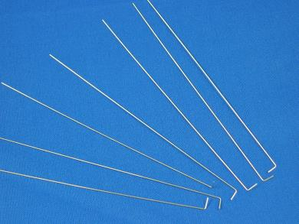
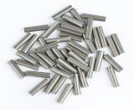
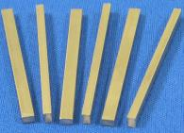
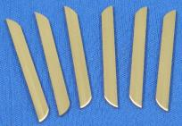
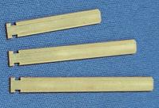
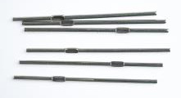
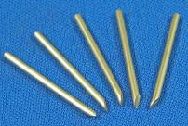
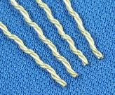
Examples of Products

Slide 7
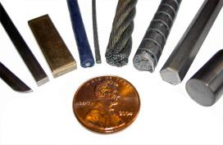
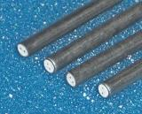
Examples of Products
Tolerance Capability:
Burr Free Cut
Length tolerance down to +/- .002
Diameters up to .250”
All Linear material types

Slide 8
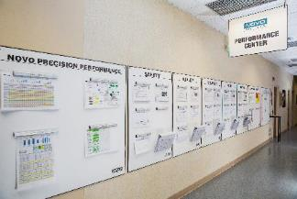
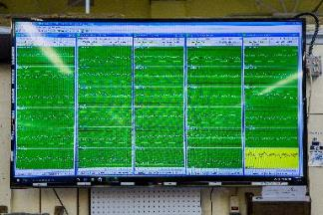
Novo as a Supply Chain Partner
Novo is driven to be a ‘World Class Supplier’ driven around Continuous Improvement
Quality:
ISO 9001-2008
Control Plans
Vision / Real Time SPC
PFMEA / FMEA to proactively attack problems
Delivery:
Make & Deliver Complete
Pull System to minimize Lead-times
Dock to Stock with Medical Customers
Cost:
Very competitive – Focused on being a strategic partner
Daily / Weekly Improvements
Joint Cost our Projects with Customers

Slide 9
Next Steps
We can review parts and have quote back to you within 48 Hours
We will work with you to quickly develop prototypes & prove process capability
We would be like to schedule a visit to help you better understand the value & capabilities that we have to help address your business needs

